Slide 1



Fourth Annual Conference on Large Hadron Collider Physics
Results from proton–lead collisions
André Mischke
Utrecht University
Notes:
<number>

Slide 2
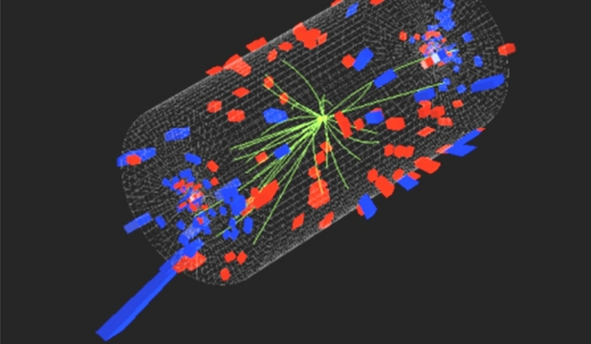
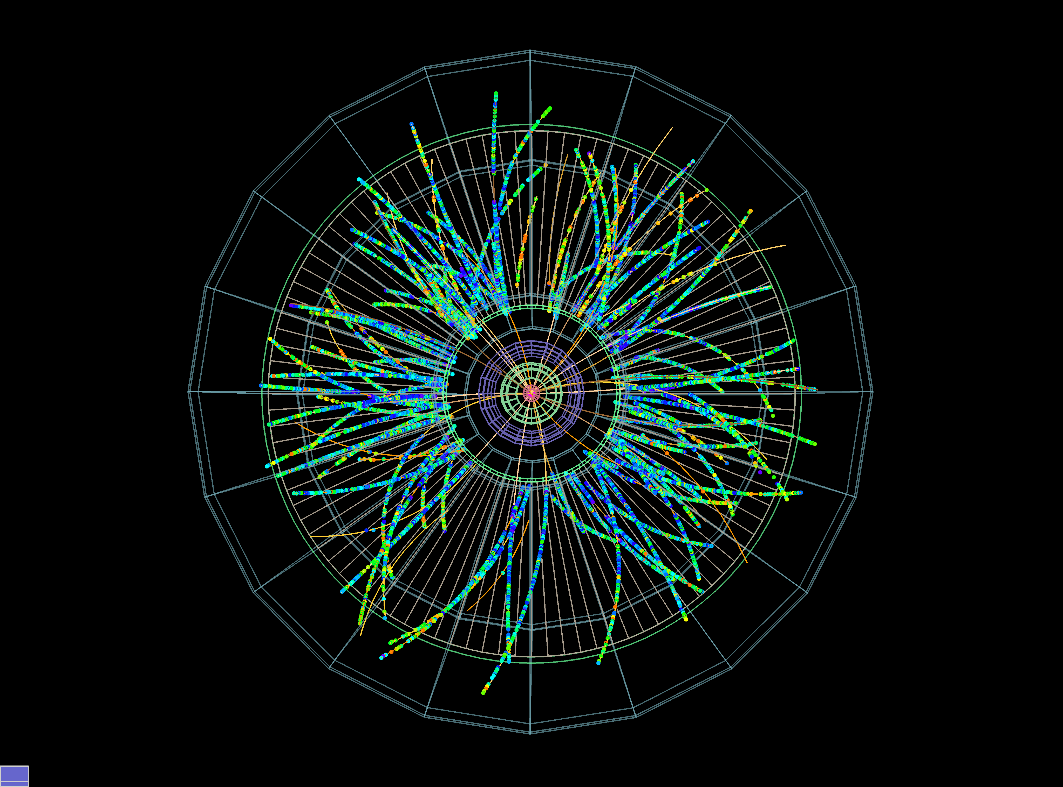




Outline
Introduction
Selected results from LHC experiments ALICE, ATLAS, CMS and LHCb
Light flavour: strangeness
Azimuthal correlations and jets
Open and hidden heavy-flavour
Summary and outlook
2013 proton-lead data
Andre Mischke (Utrecht)
<number>

Slide 3
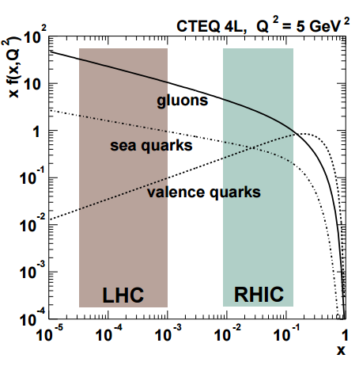
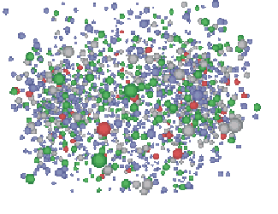
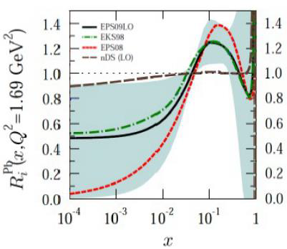
Cold nuclear matter (CNM) effects
Study cold nuclear matter effects (from initial state) such as
Nuclear modification of PDFs → shadowing at low Bjørken-x (dominant at LHC)
Gluon saturation from evolution equations (DGLAP and BFKL)
k_{T} broadening and Cronin enhancement from multiple parton scatterings
Initial-state energy loss
Final-state effects
Energy loss?
Interactions between final-state particles (collective expansion?)
Crucial for test of pQCD calculations and interpretation of heavy-ion results
K.J. Eskola, H. Paukkunen, C. A. Salgado, JHEP 0904, 65 (2009)
Andre Mischke (Utrecht)
K. Mueller, QCD parallel, 13 June
<number>
Notes:
Fabio, p.24
<number>

Slide 4
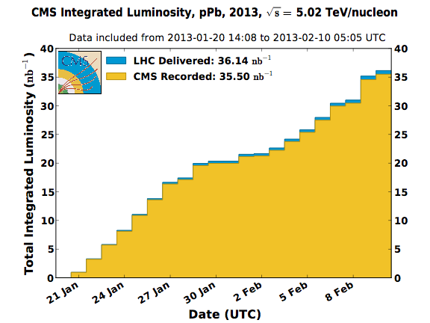
Data sets
Lead beam (²⁰⁸₈₂Pb) with an energy of 1.58 TeV per nucleon and opposing proton beam with an energy of 4 TeV
→ p-Pb collisions with cms energy of √s_{NN} = 5.02 TeV
13 bunches were circulating with about 10¹⁰ protons and 6×10⁷ Pb ions per bunch
Very successful end of LHC run-1 data taking in 2013
Highest transverse density
Δy_{cms} = 0.465 (in proton direction)
Experiment | Integrated luminosity
ALICE | ~50 μb⁻¹
ATLAS | ~30 nb⁻¹
CMS | ~35 nb⁻¹
LHCb | ~1.6 nb⁻¹
Data taking example
Andre Mischke (Utrecht)
Notes:
Two-particle correlation functions and the extracted source radii are presented as a function of average transverse pair momentum (kT) and collision centrality.
<number>

Slide 5
Light flavour
Andre Mischke (Utrecht)
<number>

Slide 6
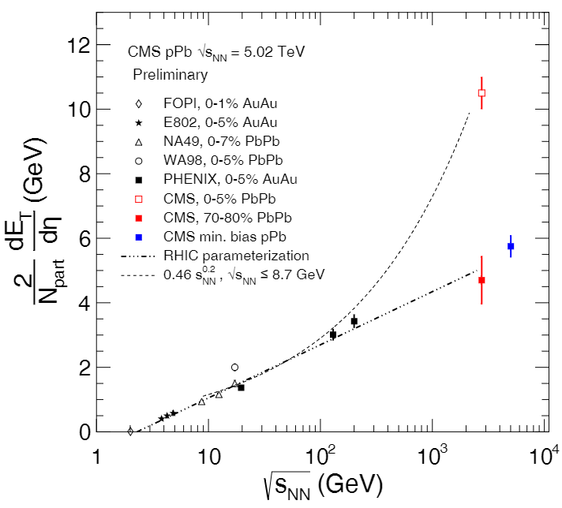
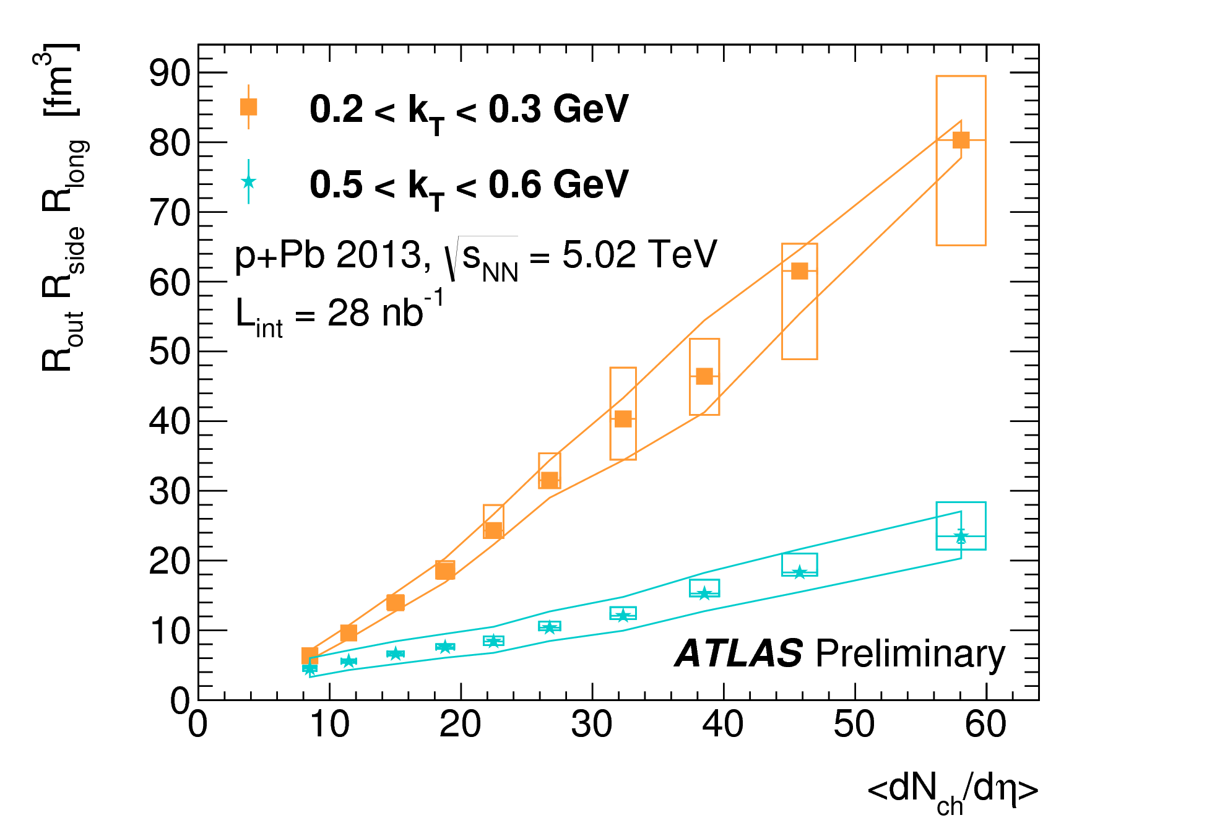
Global event properties
Transverse energy density
Charged pion HBT measurements: size of particle emitting source
(𝑑𝐸_{𝑇}/𝑑𝜂)/(𝑁_{𝑝𝑎𝑟𝑡}/2) ~ 5.8 GeV
CMS-HIN-14-014
ATLAS-CONF-2015-054
Average transverse pair momentum (k_{T})
Transverse energy density per participant pair in p-Pb at 5.02 TeV is bigger than 70-80% Pb-Pb at 2.76 TeV
Source volume ~ ⟨dN/dη⟩
→ Indicating a constant source density at the moment of freeze-out
Andre Mischke (Utrecht)

Slide 7
Pseudorapidity density of charged particles
ALICE, Phys. Rev. Lett. 110, 032301 (2013)
Measured over 4 units of pseudorapidity in non-single diffractive (NSD) p-Pb collisions
Most model predictions within 20% of data
Saturation Models rise too steeply with η_{lab}
pQCD-based Monte Carlo models (HIJING and DPMJET) describe dn_{ch}/dη_{lab}
η_{lab} = – ln tan(θ/2)
Andre Mischke (Utrecht)
<number>
Notes:
Non Single Diffractive (NSD) events are actually the sum of Non-Diffractive (ND) and Double Diffractive (DD) events
In diffractive events an incident particle is excited. A so-called diffractive system is created that carries the quantum numbers of the respective incoming particle (except possibly the spin). Subsequently it evolves and decays.
Non-diffractive collisions have many particles in the central region, steeply falling to higher rapidities.
In a single-diffractive collision only one of the beam particles breaks up and produces particles at high rapidities on one side.
In a double-diffractive collision both beam particles break up and produce particles at positive and negative high rapidities.
<number>

Slide 8
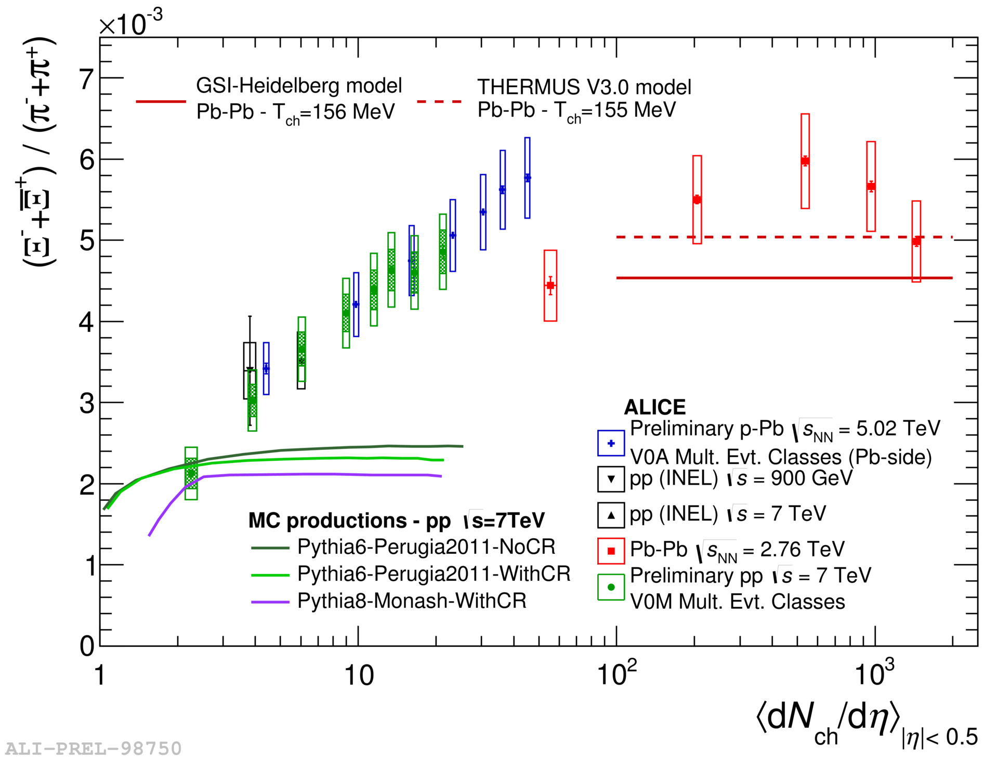
Multi-strange particles vs. multiplicity
ALICE, PLB 758 (2016) 389 and PLB 728 (2014) 25
Looser concept of ‘centrality’ in pp collisions
fluctuations in momentum transfer
internal proton structure
Similar multiplicity dependence in pp and p-Pb
Neither PYTHIA 6 nor 8 reproduce data in any of the tunes tested
Continuous reduction of canonical suppression with increasing multiplicity
Pb-Pb
p-Pb
pp
Charge particle multiplicity
Andre Mischke (Utrecht)

Slide 9
Jets
Andre Mischke (Utrecht)
<number>

Slide 10
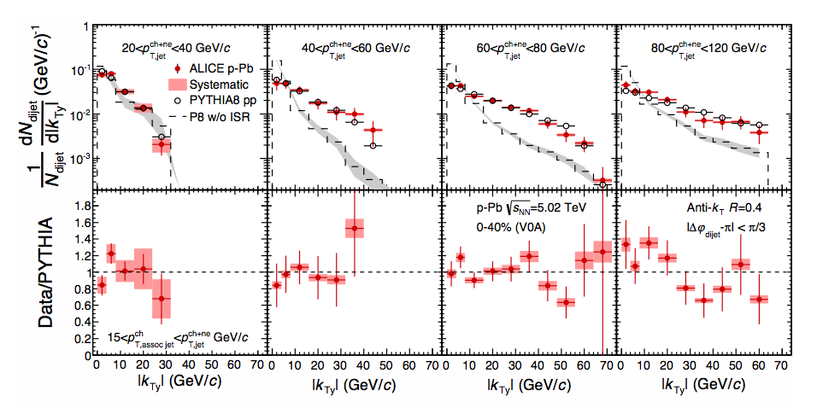
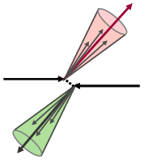
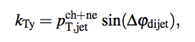
Acoplanarity between full and charged jets
ALICE, Phys. Lett. B746 (2015) 385
Di-jet k_{Ty} consistent with Pythia predictions (with ISR)
→ No strong nuclear matter effects in measured kinematic range
→ For large Q² mainly sensitive to increased available phase-space for QCD radiation processes
Dijet transverse momentum
Andre Mischke (Utrecht)

Slide 11
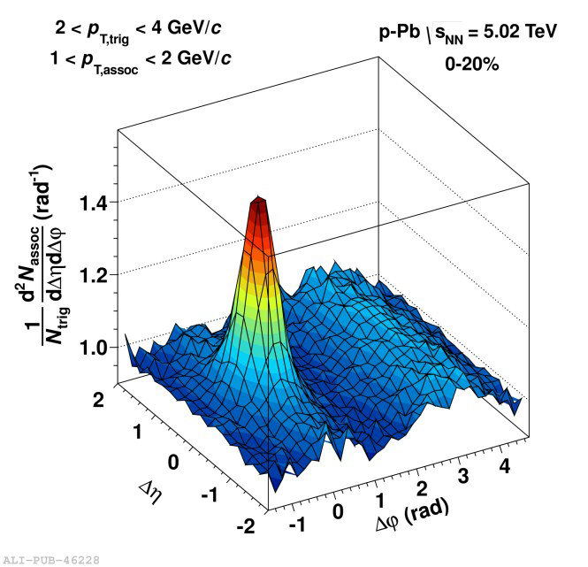
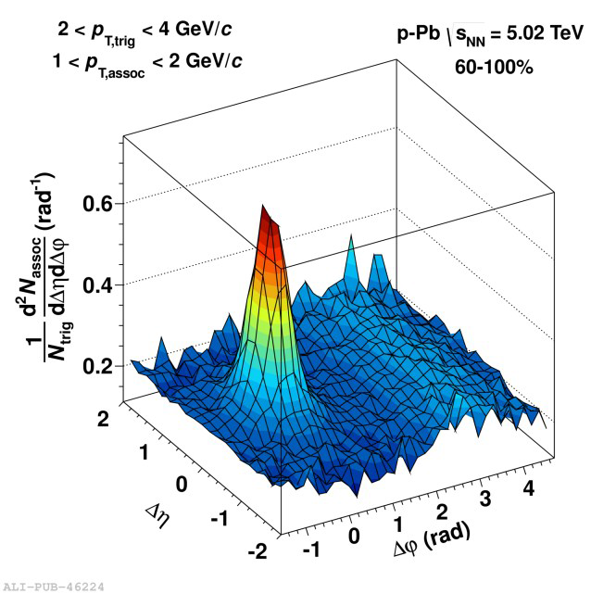
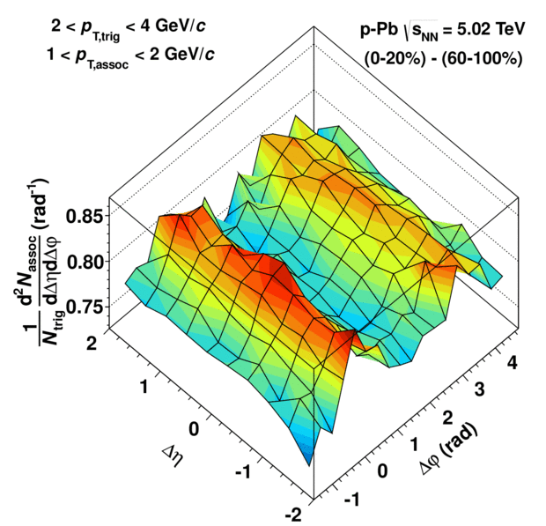
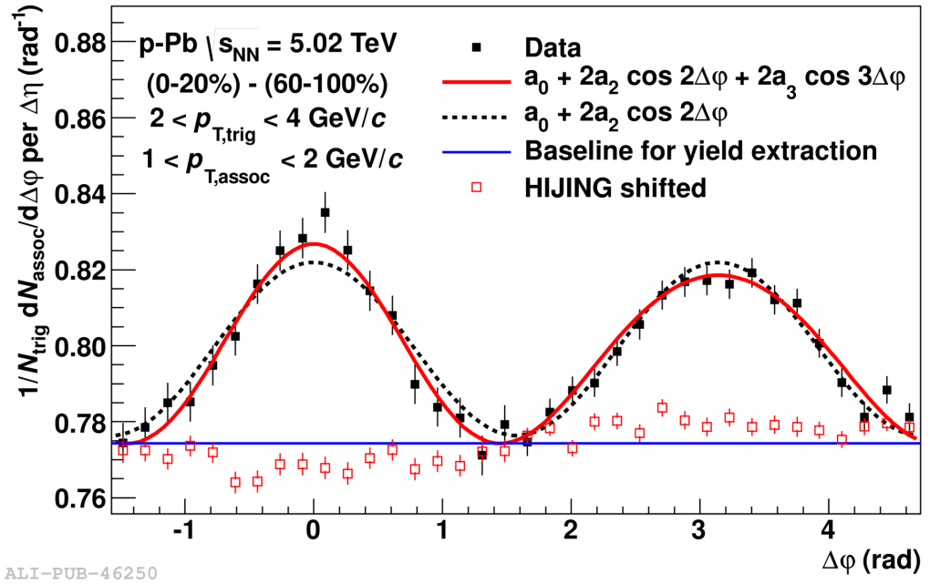
Di-hadron azimuthal correlations
-
=
ALICE, PLB 719, 29 (2013)
Two long-range (double ridge) structures described by
- colour glass condensate (initial state effect) - hydrodynamics (final state effect)
Unexpected collective (?) behaviour in high-multiplicity events at low p_{T} seen even in the small p-Pb system
Jets suggest no significant CNM effects
Also measured by LHCb, arXiv:1512.00439 and CMS, PLB 718 (2012) 795 and ATLAS, PRL 110 (2013) 182302
Andre Mischke (Utrecht)
<number>

Slide 12
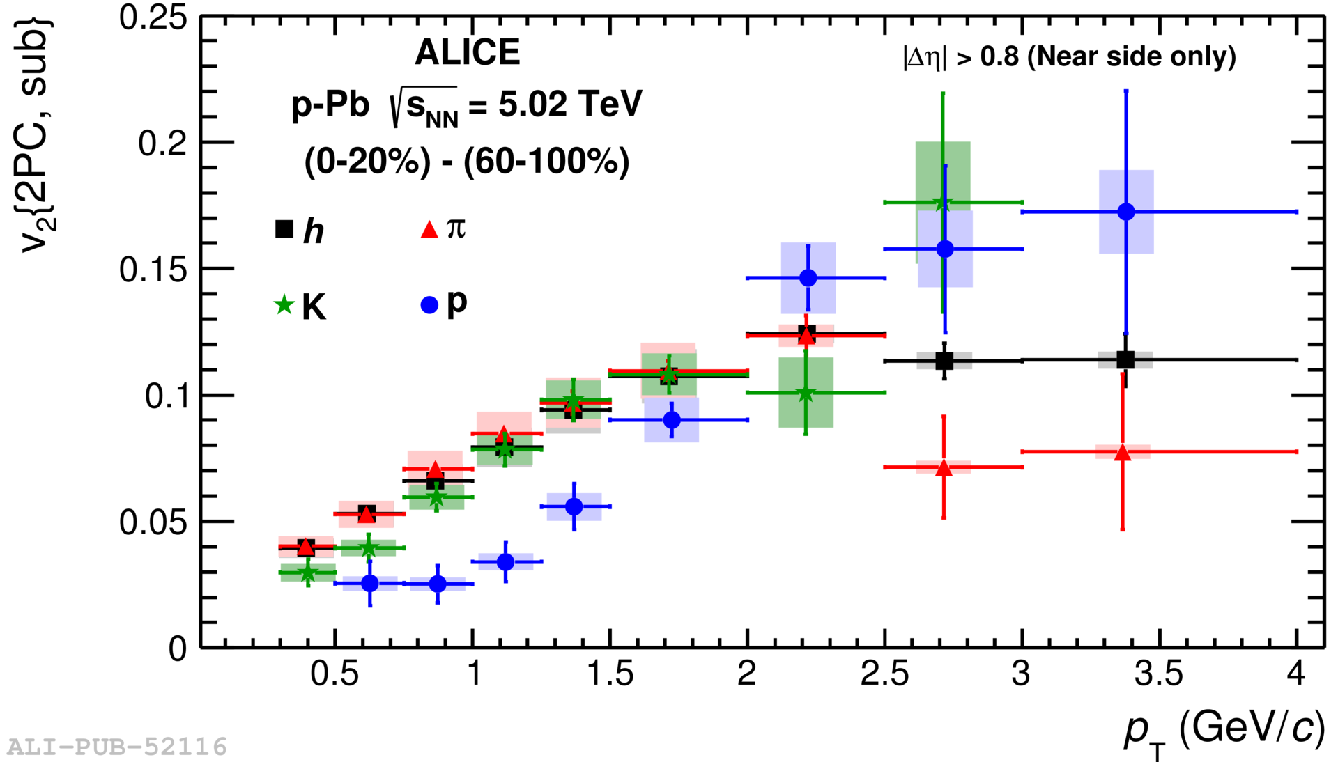
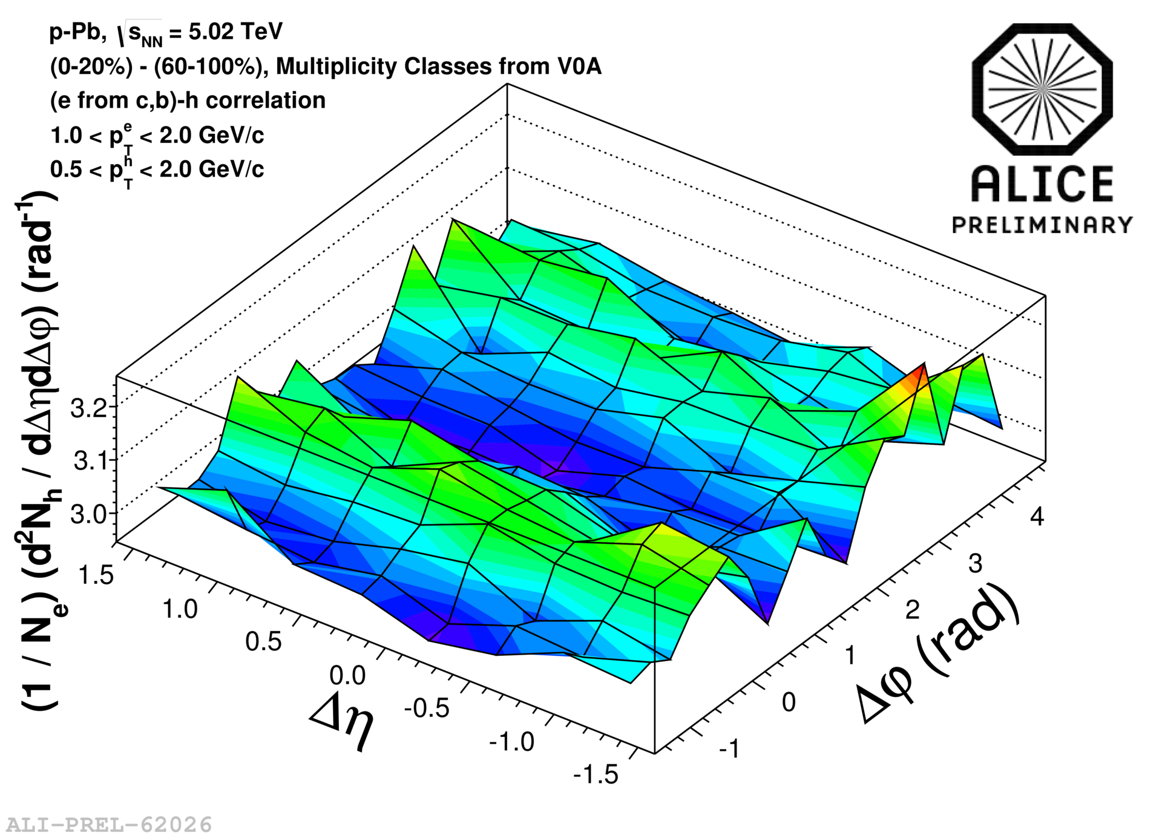
Di-hadron correlations in p-Pb (cont’d)
hadron – (π, K, p) correlations
b,c→e – hadron correlations
Phys. Lett. B 726, 164 (2013)
Also for Λ and K_{s}⁰, CMS-HIN-15-006
v₂ obtained from two-particles correlations
- Mass ordering at low p_{T}
- Crossing at p_{T} ~ 2 GeV/c
Qualitatively similar to Pb-Pb and consistent with hydro calculations
→ Suggests similar physics (collectivity?) at place?
Double ridge structure also present
Suggests same mechanism as for light-flavour correlations
Theoretical interpretation ongoing
Small Systems session, Heavy Ion, 14 June
Andre Mischke (Utrecht)
<number>

Slide 13
D-tagged charged particle azimuthal correlations
Δφ distribution Near-side correlation yield & width
ALICE, subm. to EPJC (arXiv:1605.06963)
yield
width
First D meson - charged hadron correlation measurement at the LHC
Near-side correlation peak is sensitive to characteristics of jet containing D meson
Similar yields for p-Pb and pp (not shown)
Data well reproduced by PYTHIA (in all kinematic ranges)
Andre Mischke (Utrecht)
<number>

Slide 14
Quantification of nuclear effects
A
Proton-lead collisions: single proton hits multiple nucleons, number depends on impact parameter b (⟨N_{coll}⟩ ≈ 7)
Nuclear modification factor R_{pPb}
Centrality/multiplicity-dependent nuclear modification factor Q_{pPb}
Collision centrality expressed in terms of nuclear overlap function T_{pPb}
T_{pPb} and N_{coll} determination relies on assumption that charged-particle multiplicity at mid-rapidity scales linearly with N_{part}
pp reference data at √s = 7 TeV (if not indicated otherwise)
If R_{pPb} and Q_{pPb} = 1 → no nuclear matter effects → binary collision scaling
Andre Mischke (Utrecht)
<number>
Notes:
Jeremy, p.8
<number>

Slide 15
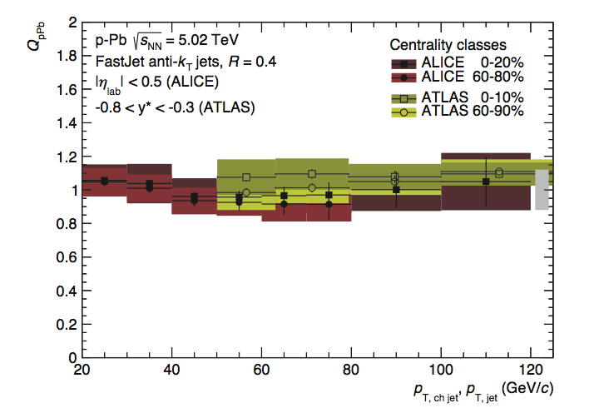
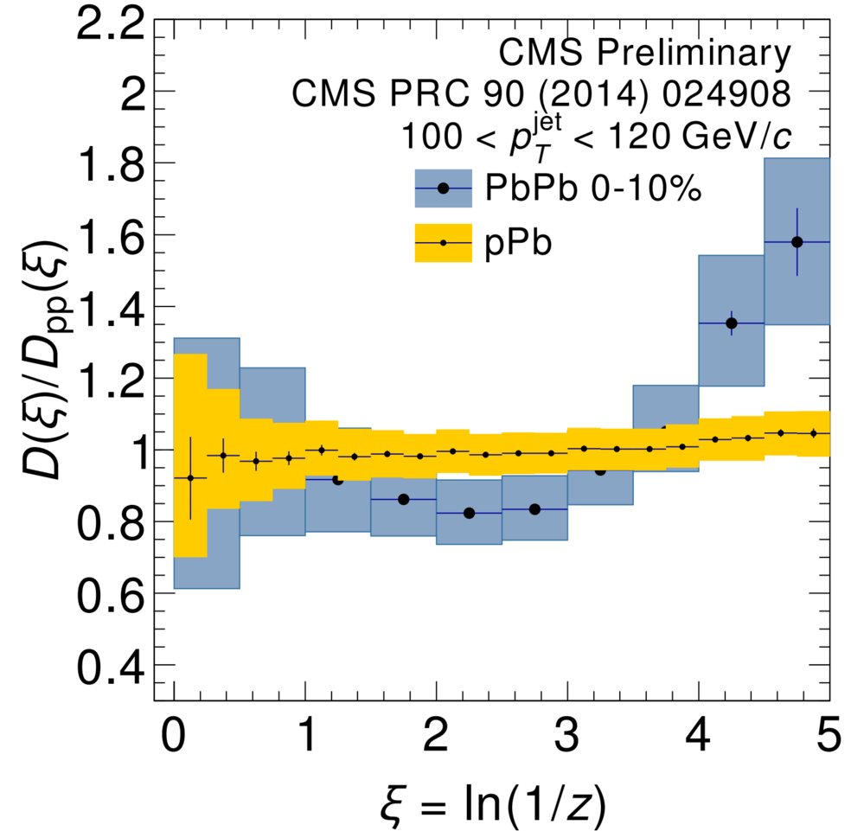
Full and charged jet production
ALICE, Eur. Phys. J. C76, 271 (2016), Phys. Rev. C91, 064905 (2015)
ATLAS, Phys. Lett. B 748, 392 (2015)
CMS-PAS-HIN-15-004
versus centrality
← high-p_{T} tracks low-p_{T} tracks →
Q_{pPb}~1 for all centralities and independent on jet p_{T}
Dependence on resolution parameter R as expected in pp
Jet fragmentation function is unmodified with respect to the interpolated pp reference → no CNM effects
Also ATLAS measurement, PLB 748 (2015) 392
Andre Mischke (Utrecht)

Slide 16
Heavy-flavour
Andre Mischke (Utrecht)
<number>

Slide 17
Prompt D mesons at mid-rapidity
ALICE, subm. to JHEP (arXiv:1605.07569) and Phys. Rev. Lett. 113 (2014) 232301
Models with CNM effects only
Models with small QGP
R_{pA} (measured down to p_{T} = 0) compatible with unity; no centrality dependence (not shown)
- Consistent with predictions from shadowing and CGC model
Data disfavour suppression larger than 15% at high p_{T}
Andre Mischke (Utrecht)
<number>

Slide 18
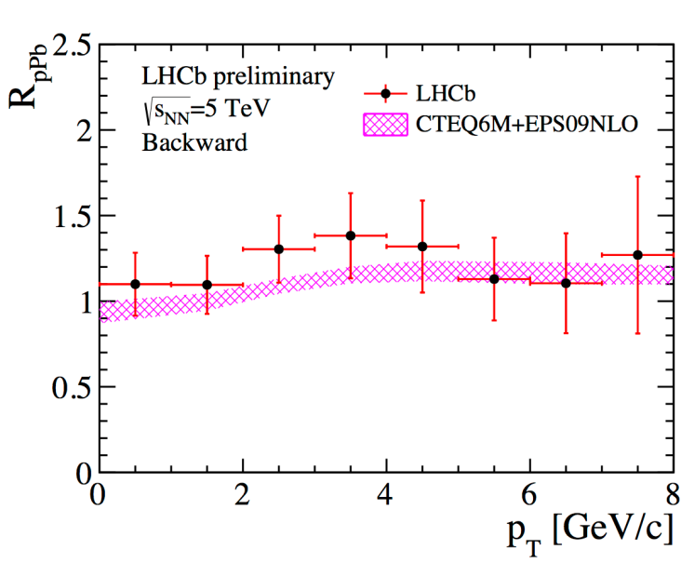
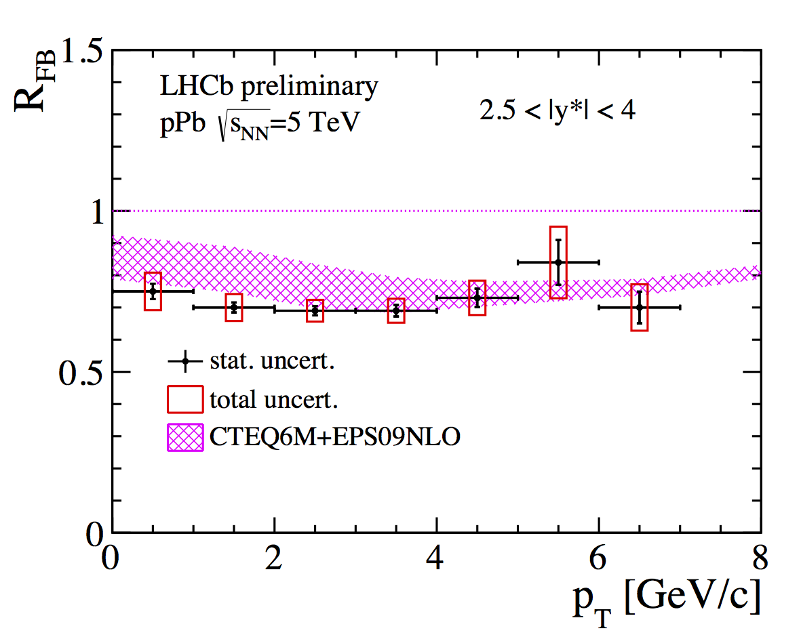
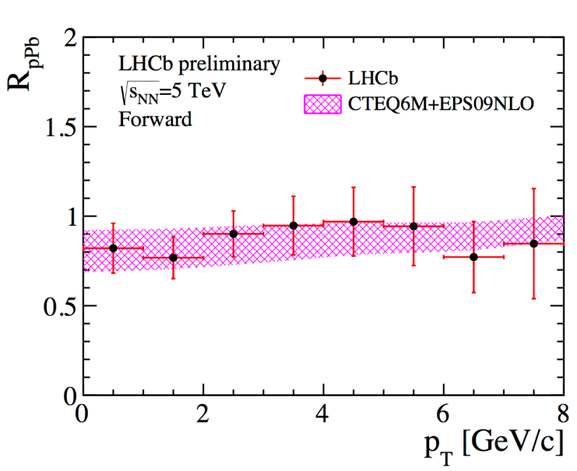
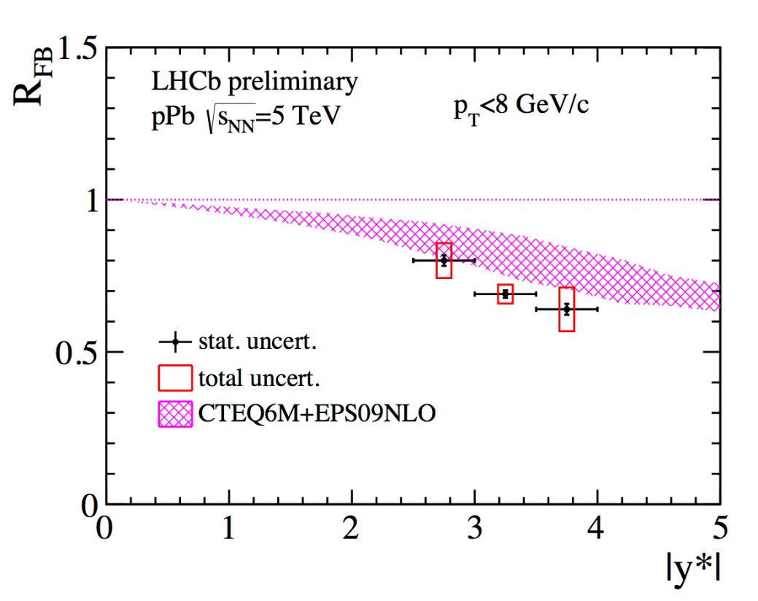
Prompt D⁰ mesons at for/backward rapidity
LHCb-CONF-2016-003
Backward rapidity -2.5 > y > -4.0
(Pb-going side)
L_{int} = 0.158±0.002 nb⁻¹
Forward rapidity
2.5 < y < 4.0
(p-going side)
Charm production described by pQCD calculations including nPDF
Large asymmetry in forward-backward production is observed, suggesting non negligible CNM effect
Indication that data is slightly more suppressed at high-y*
Andre Mischke (Utrecht)

Slide 19
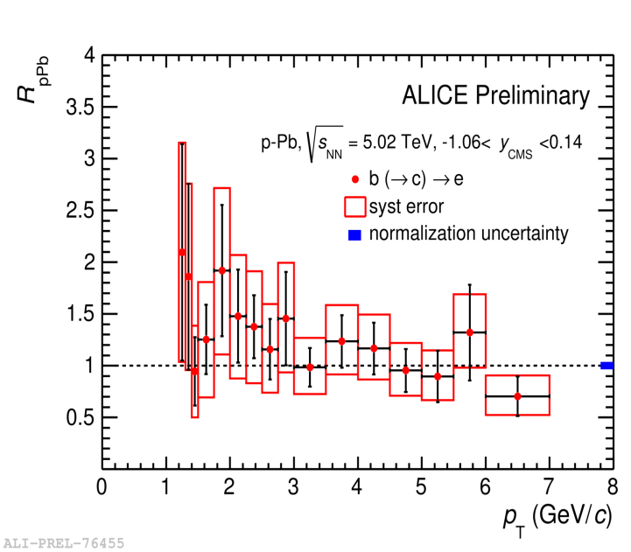
Open beauty
Beauty-decay electrons B mesons
ALICE, arXiv:1512.02892
CMS, PRL 116 (2016) 032301
B⁺ → J/ψK⁺ → μ⁺μ⁻K⁺
R_{pPb} of beauty-decay electrons at low p_{T} and B mesons in 10 < p_{T} < 60 GeV/c consistent with unity; same for B⁰ and B_{s}⁰ R_{p-Pb} (not shown)
No indication of significant cold nuclear matter effects on beauty production
Andre Mischke (Utrecht)

Slide 20
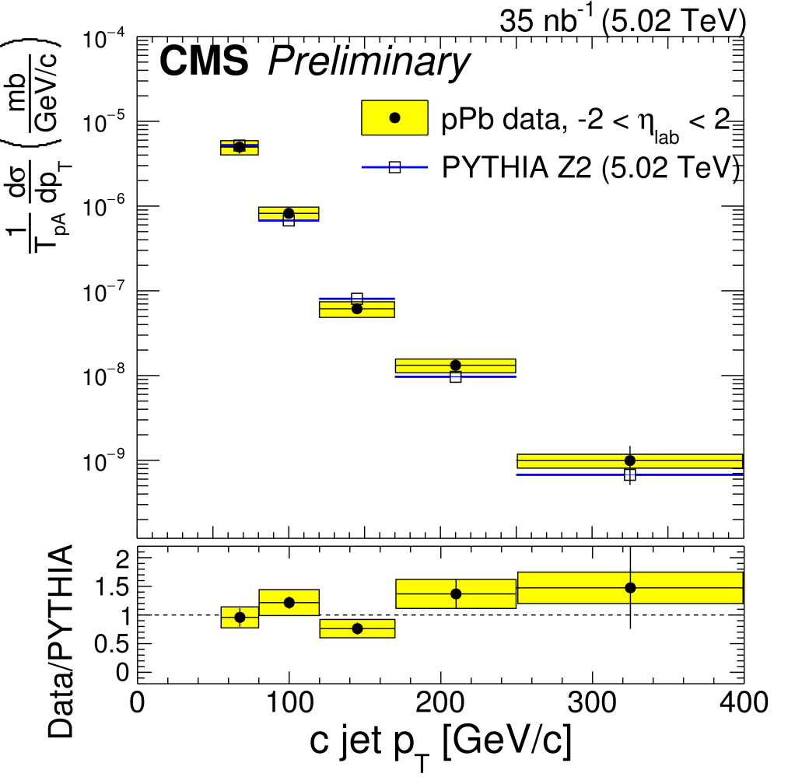
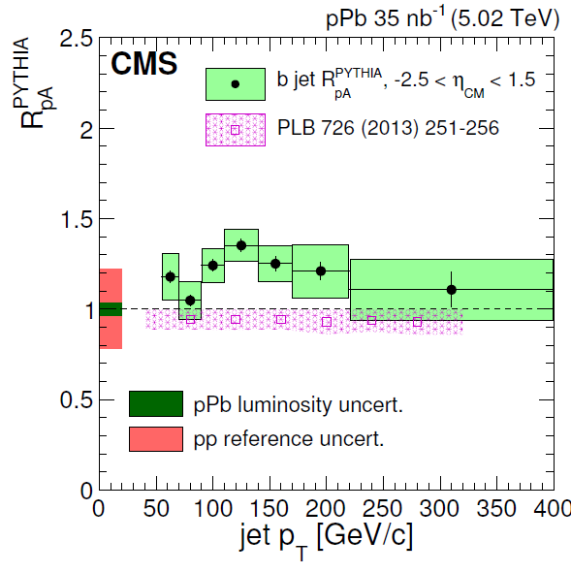
Heavy-flavour jets
Charm jets Beauty jets
CMS-PAS-HIN-15-012
CMS, PLB 754 (2016) 59
pQCD incl. modest initial-state energy-loss effects, K. Huang, Z. Kang, I. Vitev
Charm-jet p_{T} differential cross section consistent with PYTHIA
Inclusive beauty jet R_{p-Pb} in agreement with pp reference
No significant CNM effects on heavy-flavour production at high p_{T}
Andre Mischke (Utrecht)

Slide 21
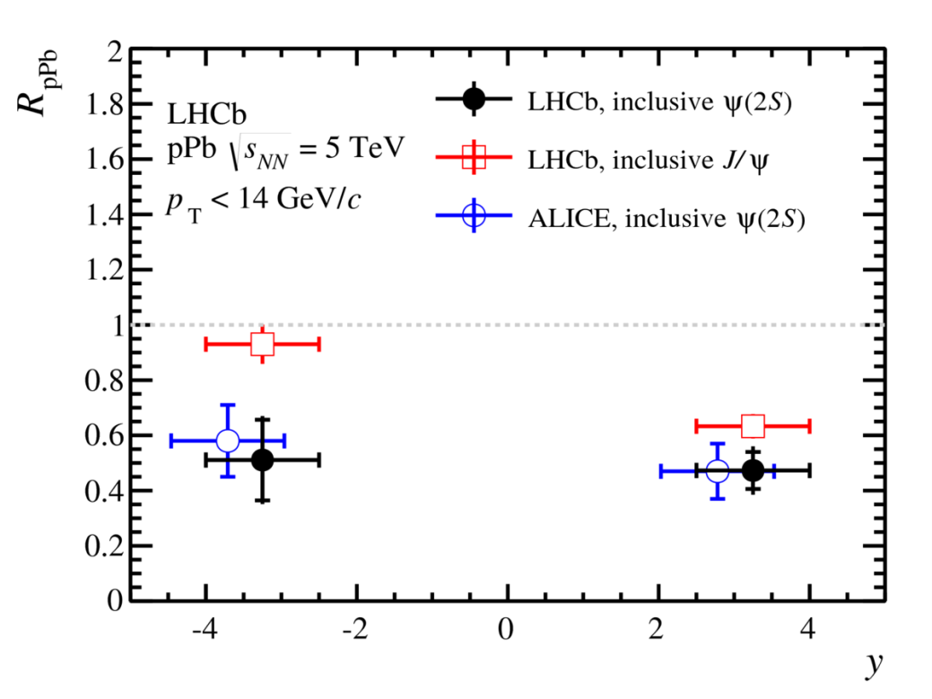
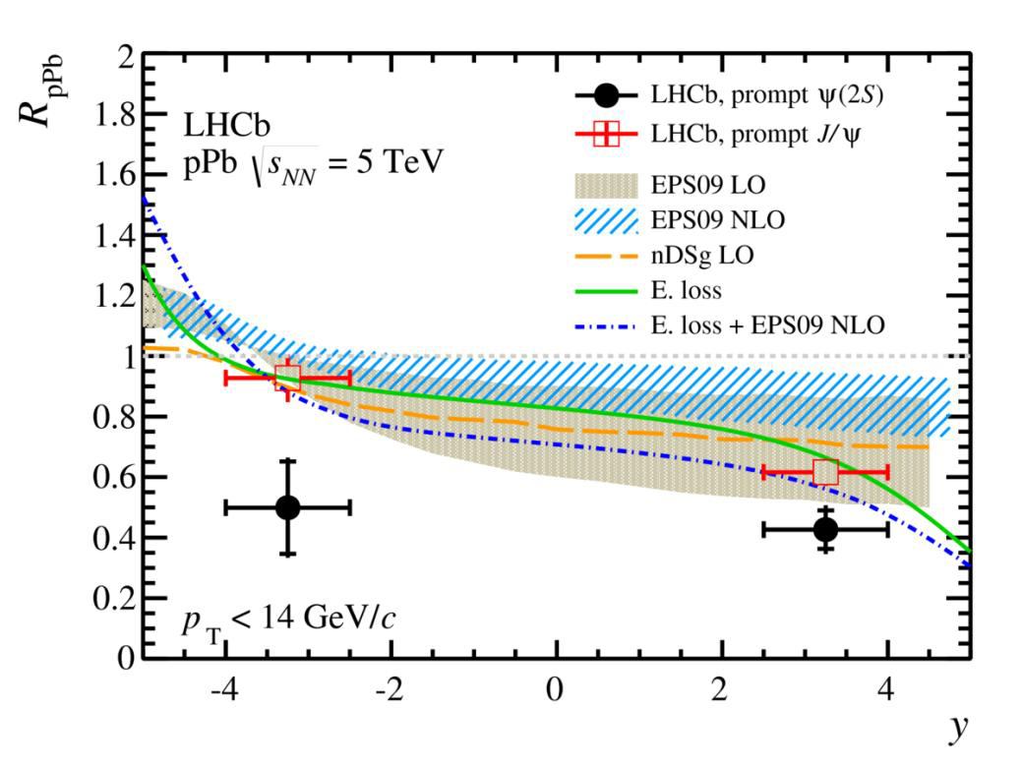
J/ψ and Ψ(2S)
Inclusive Prompt
LHCb, JHEP 1402 (2014) 072 and JHEP 1603 (2016) 133
ALICE, JHEP 1402 (2014) 073 and JHEP 1412 (2014) 073
← Pb proton →
J/ψ R_{pPb} described reasonably well by CNM effects
Ψ(2S) production suppressed relative to J/ψ at both backward and forward rapidity
→ Shadowing & energy loss expected to be the same for J/ψ and Ψ(2S), thus these mechanisms cannot describe the different suppression
Andre Mischke (Utrecht)

Slide 22
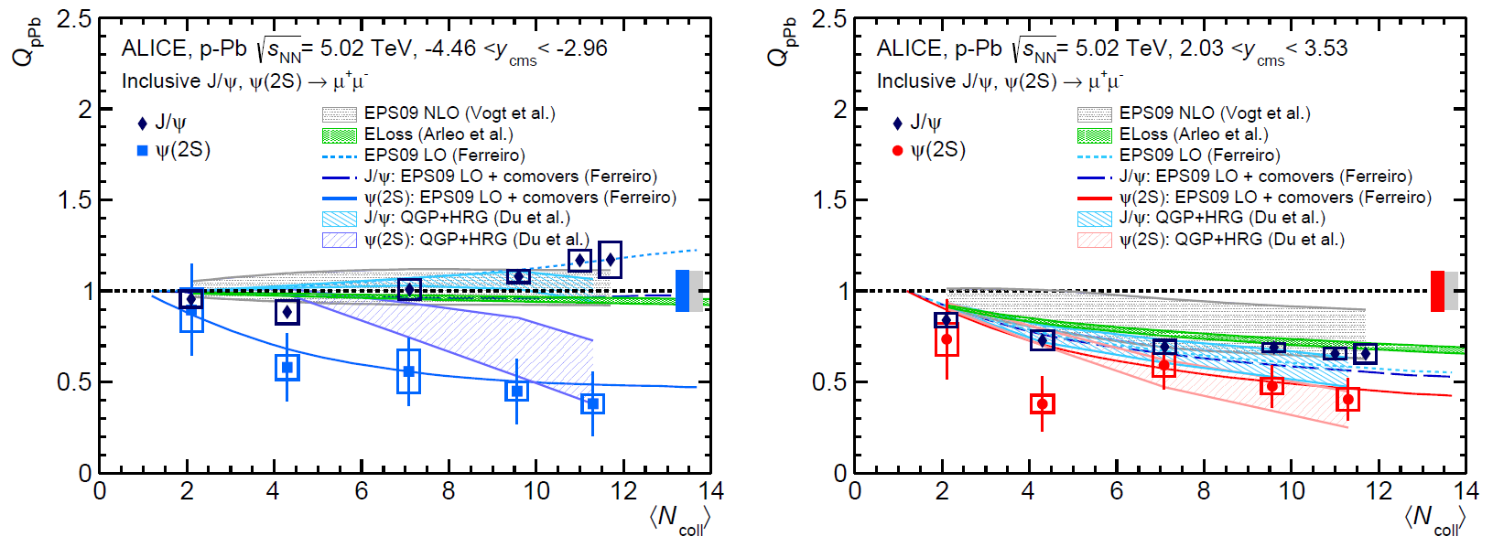
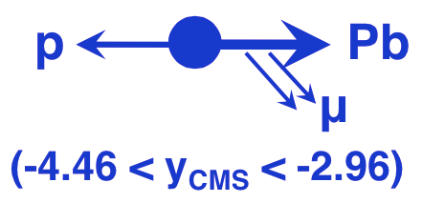
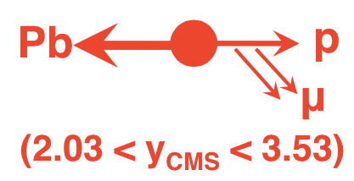
J/ψ and Ψ(2S) versus centrality
Backward rapidity (Pb-going side)
Forward rapidity (p-going side)
ALICE, JHEP 1606 (2016) 050 and JHEP 1511 (2015) 127
J/ψ: Multiplicity dependent suppression in p-going direction, and no suppression in Pb-going direction → Consistent with shadowing
Ψ(2S): Multiplicity dependent suppression in both directions
Not described by (anti)shadowing and energy loss only
Needs additional effect (final state?), e.g., interactions with co-moving hadrons plus dissociation of fully-formed resonance in nuclear matter?
Andre Mischke (Utrecht)

Slide 23
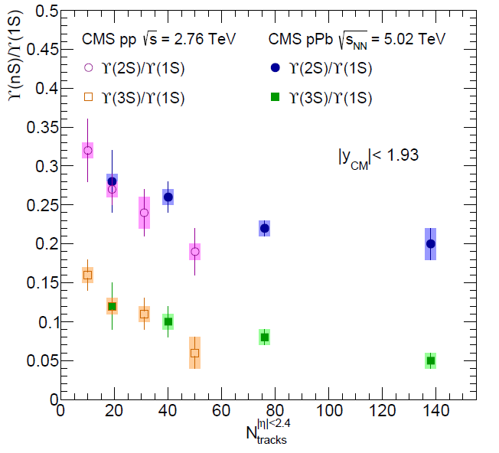
○(nS) states
CMS, JHEP 1404 (2014) 103
Ratios of excited to ground state cross sections ○(nS)/○(1S) are found to decrease with increasing charged-particle multiplicity
Unexpected dependence suggests novel phenomena in quarkonium production(?)
Larger number of charged particles being systematically produced with ground state
Stronger impact of growing number of nearby particles on more weakly bound states
Excited states more easily dissociated by interactions with other particles?
31 nb⁻¹ (pPb)
5.4 pb⁻¹ (pp)
Andre Mischke (Utrecht)

Slide 24
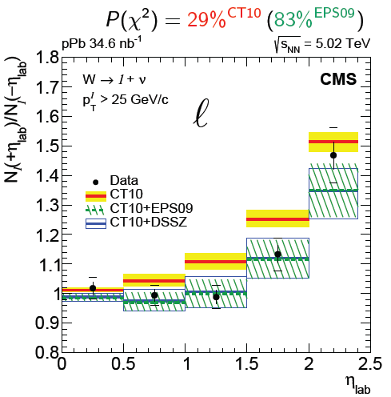
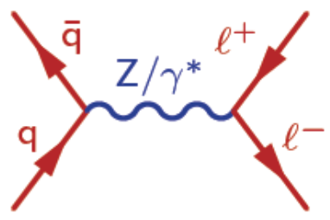
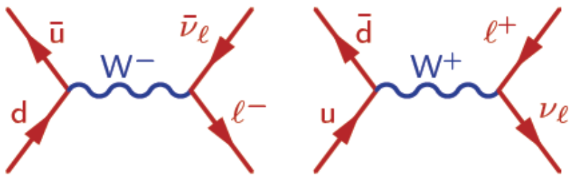
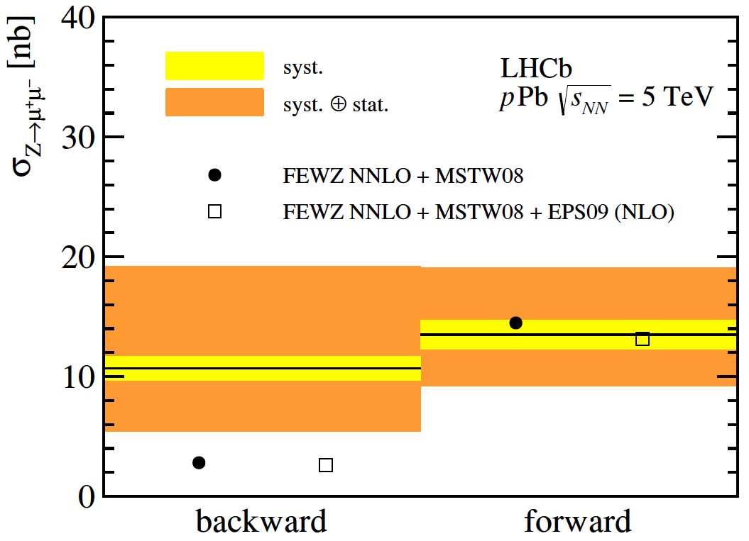
W and Z production
CMS, Phys. Lett. B750 (2015) 565
ATLAS, Phys. Rev. C 92, 044915 (2015)
p_{T}^{lepton} > 25 GeV/c
LHCb, JHEP 1409, 030 (2014)
Probing nuclear PDF for 𝑞 and 𝑞bar in p-Pb
Electroweak bosons favour the modification of nPDF
Large statistical uncertainties yet prevent distinction among different nPDFs
2.0 < η(μ±) < 4.5
p_{T}(μ±) > 20 GeV/c
60 < m_{μ+μ−} < 120 GeV/c²
Andre Mischke (Utrecht)
Notes:
𝑍⟶𝑙⁺𝑙⁻ with 𝑙 = 𝜇 or 𝑒
<number>

Slide 25
Conclusions
LHC p-Pb run at √s_{NN} = 5.02 TeV yielded many (unexpected) results: different hadronic probes and observables
Strangeness: Continuous reduction of canonical suppression with increasing multiplicity
Jet fragmentation exhibits no modification
Heavy flavour
- No significant modification of production are observed for prompt D mesons, B mesons, charm and beauty jets
- Quarkonia: J/ψ results consistent with shadowing, Ψ(2S) however not described by (anti)shadowing and energy loss only
→ No indication for substantial modification due to cold nuclear matter effects (except for quarkonia)
→ Indication for collective-like behaviour in small systems, reminiscent of that observed in Pb+Pb collisions
→ Final-state modifications in p-Pb collisions?
Future: Run-2 p-Pb data taking at 5 and 8 TeV in 2016
Andre Mischke (Utrecht)

Slide 26
Andre Mischke (Utrecht)

